Slide 1
DevOps, or how to build, test, and deploy applications like a boss
Eugene Romero
Senior DevOps Engineer
Capgemini Norge

Slide 2
Lecture plan
07 | What is DevOps? MVP Understanding CI/CD | Build and publish Python app using GitHub Actions
08 | What exactly is the Cloud? Understanding Infrastructure-As-Code | Publish Python app to the Cloud with GitHub Actions

Slide 3
What is DevOps?

Slide 4
What is DevOps?
DevOps is the combination of cultural philosophies, practices, and tools that increases an organization’s ability to deliver applications and services at high velocity: evolving and improving products at a faster pace than organizations using traditional software development and infrastructure management processes. This speed enables organizations to better serve their customers and compete more effectively in the market.
https://aws.amazon.com/devops/what-is-devops/
Notes:
Confused yet?

Slide 5
What is DevOps?

Slide 6
What is DevOps?

Slide 7
What actually IS DevOps?
Not a technology, but a culture
Aiming to make DEVelopment and OPerationS
work together for everyone’s benefit

Slide 8
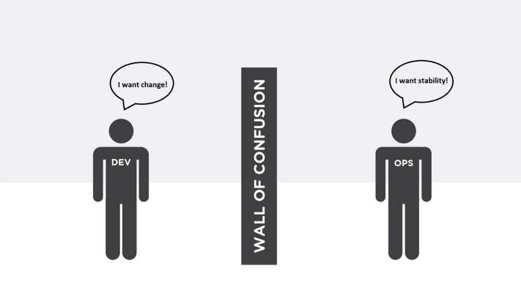
A brief history of pre-DevOps
Notes:
Historically, the goals of Developers and Operations have been opposites

Slide 9
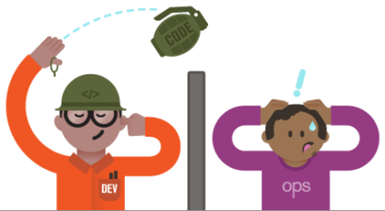
A brief history of pre-DevOps
Notes:
Many times, a culture of “fire and forget” would take root, increasing downtime and creating issues within departments

Slide 10
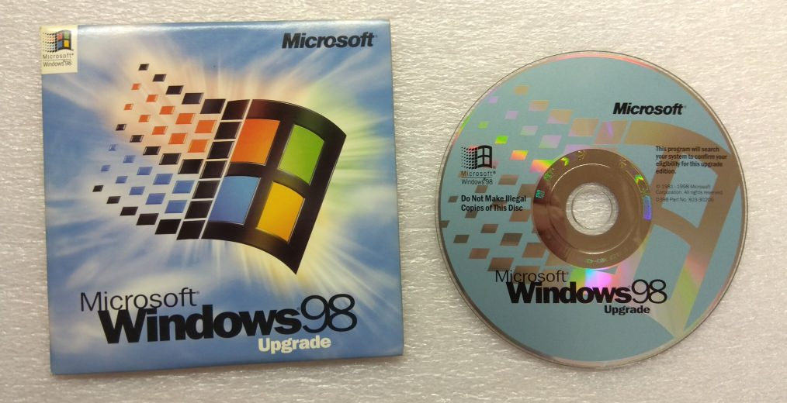
A brief history of pre-DevOps
Notes:
Part of the problem was related to the difficulty of distributing new versions of software

Slide 11
DevOps, the magical bullet
Under a DevOps model, development and operations
are no longer silos
Notes:
Same country, same building, same team even!

Slide 12
DevOps, the magical bullet
Under a DevOps model, everything is automated
Notes:
Even the lunch breaks!* *lunch breaks not automated

Slide 13
DevOps, the magical bullet
Under a DevOps model, velocity is increased, and new features are quickly delivered to end users
Notes:
Engineers no longer need help from other teams to accomplish tasks
Obtaining latest version of application
Upgrading and rolling back
Provisioning infrastructure

Slide 14
DevOps, the magical bullet
Under a DevOps model, reliability is increased, alongside rapid delivery
Notes:
DevOps principles always prefer “more and smaller” over “less and bigger”.
This leads into one of the core pillars of DevOps, MVP

Slide 15
DevOps, the magical bullet
Under a DevOps model, reliability is increased, alongside rapid delivery
Notes:
DevOps principles always prefer “more and smaller” over “less and bigger”.
This leads into one of the core pillars of DevOps, MVP

Slide 16
MVP
Notes:
(start passing Post-Its)

Slide 17





Most Valuable Player?

Slide 18
Minimum Viable Product
Notes:
Exercise:
Groups of 4/5
Write in Post-Its every thing you do before leaving house
Now, late for first class, find the most essential things
Must Haves vs Nice to Haves

Slide 19
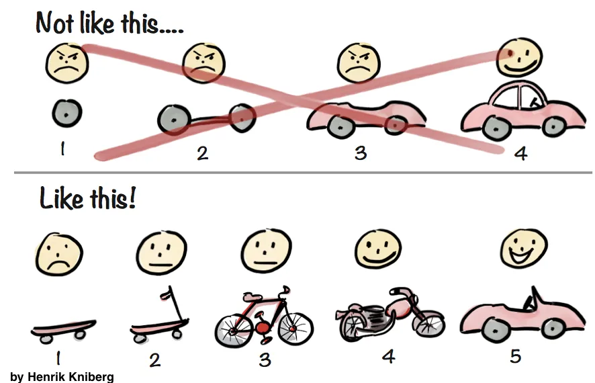
Minimum Viable Product
Notes:
Drawing
Having nice, clean, small incremental packages, nicely enables us to move into CI/CD

Slide 20
Continuous Integration / Continuous Delivery (CI/CD)

Slide 21
Continuous Integration
Automating the integration of code changes from multiple contributors into a single project

Slide 22
Continuous Integration
CI can be achieved by leveraging:
Source control system
Automated quality checks
Trunk based development
Notes:
- Git
- Automated syntax, unit, compliance tests
- Short lived branches (drawing?)

Slide 23
Continuous Delivery
Ensuring that every change can be deployed to Production
Notes:
Usually business reasons

Slide 24
Continuous Delivery
The more often we deploy...
... the better the process gets
... the smaller the changes will be
... the smaller the Time-To-Repair will be
Notes:
Explain how the deployment process used to be, including bugs and rolling back
This also allows changing course fast if needed, vs long, huge projects
How are the big guns doing?

Slide 25
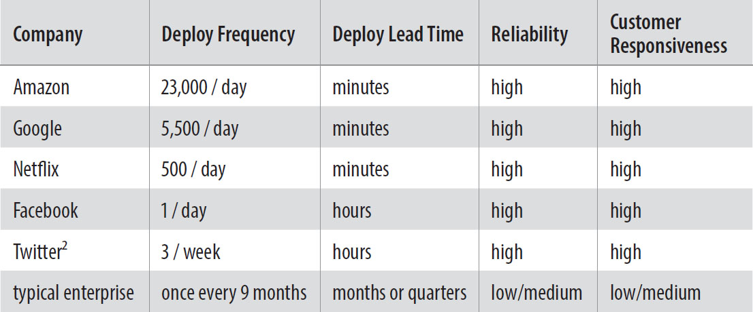
CD at the big players (in 2013!)
Notes:
To be able to achieve these numbers, it is necessary to depend on Automation

Slide 26
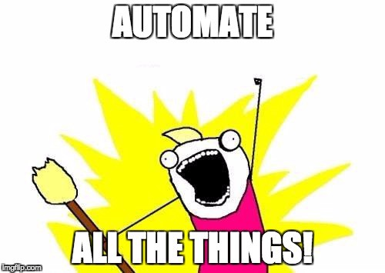
Notes:
Will need access to GitHub repo settings to add secret

Slide 27
GitHub Actions documentation
Actions Quickstart:
docs.github.com/en/actions/quickstart
Actions marketplace:
github.com/marketplace?&type=actions
Detailed syntax breakdown:
docs.github.com/en/actions/reference/workflow-syntax-for-github-actions

Slide 28
Before Friday lecture
Create Docker Hub account (hub.docker.com)
Build and publish Flask app to Docker Hub, with GitHub Actions
Run Azure CLI Docker image once (docker run --rm -it mcr.microsoft.com/azure-cli) [type exit to quit app]
Create free Azure Student account (azure.microsoft.com/en-us/free/students/)

